Slide 1
RESPIRATORY SYSTEM – HISTORY, EXAM, INVESTIGATIONS, MANAGEMENT
Dr. Diana Marangu
Lecturer, Consultant Paediatrician & Pulmonologist
27th January 2020

Slide 2
History Components
Bio Data/ Identifying Data
Chief complaints
History of presenting illness
Past medical history
Perinatal history*
Growth history*
Developmental history*
Nutrition history*
Immunization history*
Family history
Social history*
Review of systems
Summary

Slide 3
Bio Data/ Identifying Data
Name
Age
Sex
Informant* (children are usually brought to the facility by their caregivers e.g. mother, father, grandmother, nanny)
Significant known medical illness; Residence; Facility referred from as applicable

Slide 4
Chief Complaint(s)
Brief statement of the problem that lead the caregiver to seek care (in caregiver’s words) and duration (get a sense if acute/chronic)
Listed in chronological order
Example:
Cough 4/7
Hotness of body 3/7
Difficulty in breathing 2/7

Slide 5
History of Presenting Illness (HPI)
Each chief complaint is described in detail in an intelligent manner
when and how it began
character of the symptoms
aggravating or alleviating factors
pertinent positives and negatives
any past diagnostic testing
Characteristics may differ based on complaint

Slide 6
Example
Example of “Cough 3/52”:
For the past 3 weeks Andrew has been coughing mainly at night
His symptoms progressed in the past 2 days with cough spasms; he coughs to the extent he vomits.
The cough is associated with wheeze.
It is relieved by using inhaler medication and is worse in the cold seasons.
He is also known to be atopic (eczema).
He has no fevers/weight loss, has been growing well and generally a playful child when not having the ‘cough attacks’

Slide 7
Past Medical History
Known chronic illnesses and current treatment
E.g. Asthma, Diabetes, Sickle cell disease
Hospitalizations including past surgeries
Outpatient visits
E.g. treated on 4 occasions for otitis media [immunodeficiency? – primary or acquired]
Blood transfusions
Known allergies to medication

Slide 8
Perinatal History*
Antenatal History
ANC visits and gestational age; Folate & iron supplements; Tetanus vaccine?
Blood group, HIV/VDRL/Urinalysis/TB results?
Risk factors for neonatal sepsis e.g. maternal fever?, UTI? PROM > 18 hrs?
Birth history
Obstetrical complications
Gestational age at birth; Type of delivery; Birth weight; APGAR score
Postnatal history
Length of hospital stay
Complications (e.g. infection, jaundice); Treatment (e.g. O_{2,} ventilation etc)
[CORROBORATE WITH MOTHER AND CHILD BOOKLET]

Slide 9
MCH BOOKLET 2016

Slide 10
Nutrition History*
Exclusive breastfeeding duration
Introduction of complimentary feeds
Balanced diet? – detail constituents
Amounts (use 200ml cup to approximate)
Frequency ( 3 main meals and 2 snacks)
Consistency/Texture
Variation
Feeding technique: responsive vs. force feeding
Current diet (? Family diet – 24 hour recall)
Change in feeding habits
[SEEE MOTHER AND CHILD HEALTH HANDBOOK]

Slide 11
MCH BOOKLET 2016

Slide 12
Growth History*
Birth weight, Length, Head circumference
Birth weight: regained (2wks), doubles (6mths), triples (1yr)
Length: 0-6mths (1.5-2.5cm/mth), 6-12mths (1cm/mth)
HC: 0-3mths (2cm/m), 3-6mths (1cm/m), 6-12mths (0.5cm/m)
Curves plotted over time – standard deviations?
Weight for age: underweight? overweight?
Weight for height: wasted? severity?
Height for age: stunted?
[SEE MOTHER AND CHILD HEALTH HANDBOOK]

Slide 13
MCH BOOKLET 2016

Slide 14
Developmental History*
Age at attainment of important milestones
Relationships with siblings, peers, adults.
School grade and performance
Behavioural problems?
[SEE MOTHER AND CHILD HEALTH HANDBOOK]

Slide 15
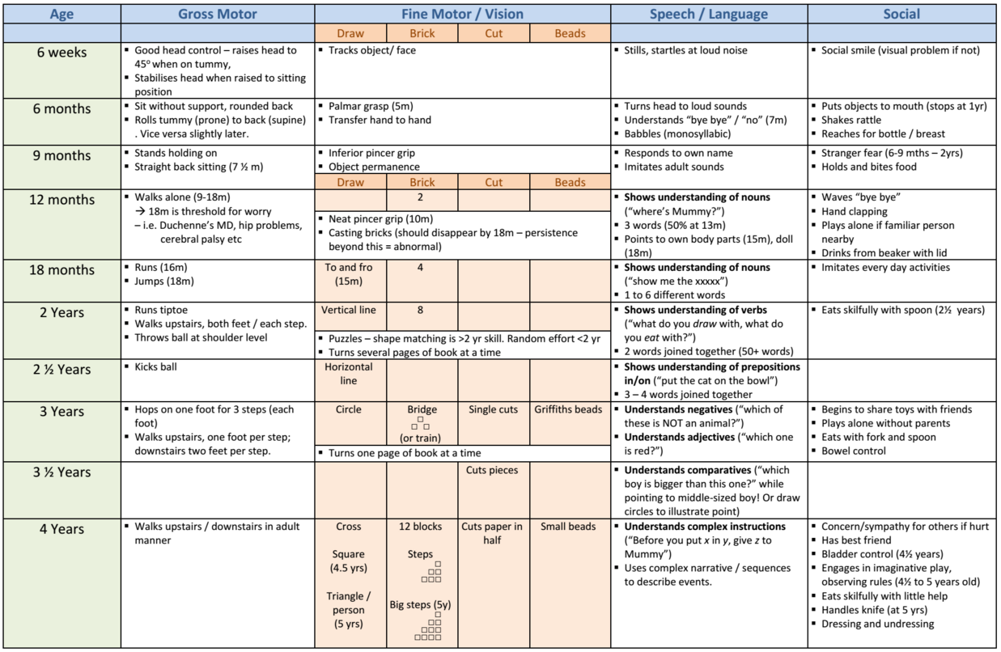
https://sites.google.com/site/glasgowuniosce/home/examination/developmental-milestones

Slide 16
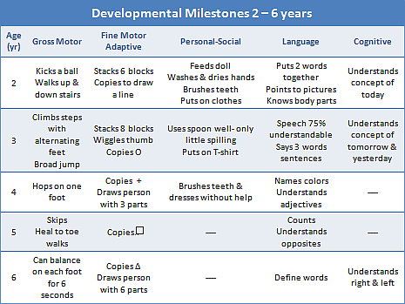
https://www.brookings.k12.sd.us/Page/1132

Slide 17
MCH BOOKLET 2016

Slide 18
Immunization History*
Immunizations: Up-to-date?
Kenya Expanded Programme of Immunizations (KEPI)
Non-KEPI vaccines
Vaccines
[SEE MOTHER AND CHILD HEALTH HANDBOOK]

Slide 19
MCH BOOKLET 2016

Slide 20
MCH BOOKLET 2016

Slide 21
Family History
Members of the family
Parents (consanguinity?); Guardian/s
Siblings
Medical problems in family, including
the patient's disorder*;
diabetes, seizures, asthma, allergies, cancer, cardiac, renal or GI disease, tuberculosis

Slide 22
Social History
Family situation
Parental level of education
Parents/Guardian’s occupation
Total household income and expenditure: detail food, rent, school fees; recreational activities* [e.g. alcohol, smoking, drugs]; Savings (approx. proportions); NHIF?
Housing: number of rooms, windows, floor type, roof type, safety features; ease of sunlight exposure
Water: source (distance from household); daily amount used; treatment and storage
Sanitation: human waste disposal (type e.g. WC toilet, VIP latrine) & household waste disposal; distance from water source
Indoor air pollution: fuel used to cook? (LPG, electricity, biomass); caregiver/other smoking - cigarette

Slide 23
Review of Systems
General: Overall health, weight loss, behavioral changes, fever, fatigue.
Skin: Rashes, bruising, lumps/bumps, nail/hair changes.
Eyes: Visual problems, eye pain.
Ear, nose, throat: Frequency of colds, pharyngitis, otitis media.
Lungs: Cough, shortness of breath, wheezing.
Cardiovascular: Chest pain, murmurs, syncope. Gastrointestinal: Nausea/vomiting, spitting up, diarrhea, recurrent abdominal pain, constipation, blood in stools.
Genitourinary: Dysuria, hematuria, polyuria, vaginal discharge.
Musculoskeletal: Weakness, joint pain, gait abnormalities, scoliosis.
Neurological: Headache, seizures.
Endocrine: Growth delay, polyphagia, excessive thirst/fluid intake, menses.

Slide 24
Summary
Summarize the history in one sentence:-
Chief complaints
Key HPI elements and
Other significant components of the history

Slide 25
RESPIRATORY EXAM
GENERAL EXAM & VITAL SIGNS (incl SPO2)
RESPIRATORY EXAM
Inspect, Palpate, Percuss, Auscultate

Slide 26
RESPIRATORY INVESTIGATIONS
LABORATORY – Bloods, Respiratory specimens
RADIOLOGY – CXR, U/S, CT etc

Slide 27
RESPIRATORY MANAGEMENT
SUPPORTIVE – Oxygen, Ventilate, Hydration etc.
DEFINITIVE – Antimicrobials etc.

Slide 28
References
Children’s Act, Constitution of Kenya 2010.
United Nation Convention on the Rights of the Child.
World Health Organization.
Hutchison’s Clinical Methods. 22nd Edition. Edited by Michael Swash and Michael Glynn.
Current Clinical Strategies in Pediatric History and Physical Examination. 4th Edition. Elizabeth K. Albright.
Mother and Child Health Handbook. Revised Edition June 2016. MOH216. Ministry of Health – Kenya. https://kenbright.co.ke/downloads/Mother%20%20Child%20Health%20Handbook%20MOH%2016032017.pdf

